Slide 1
FINAL PROJECT DEMO
GROUP 15

Slide 2
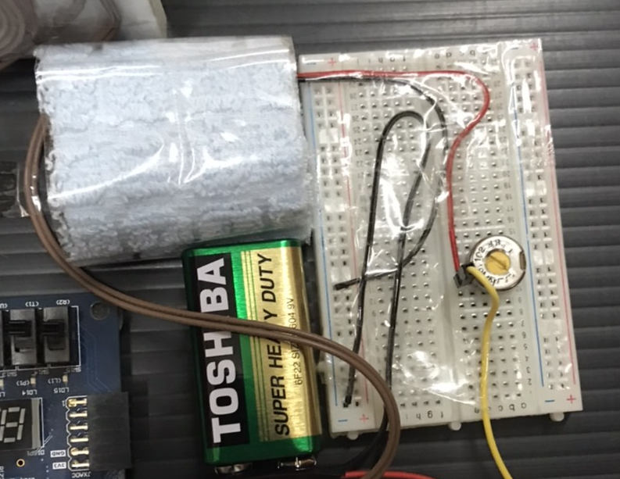
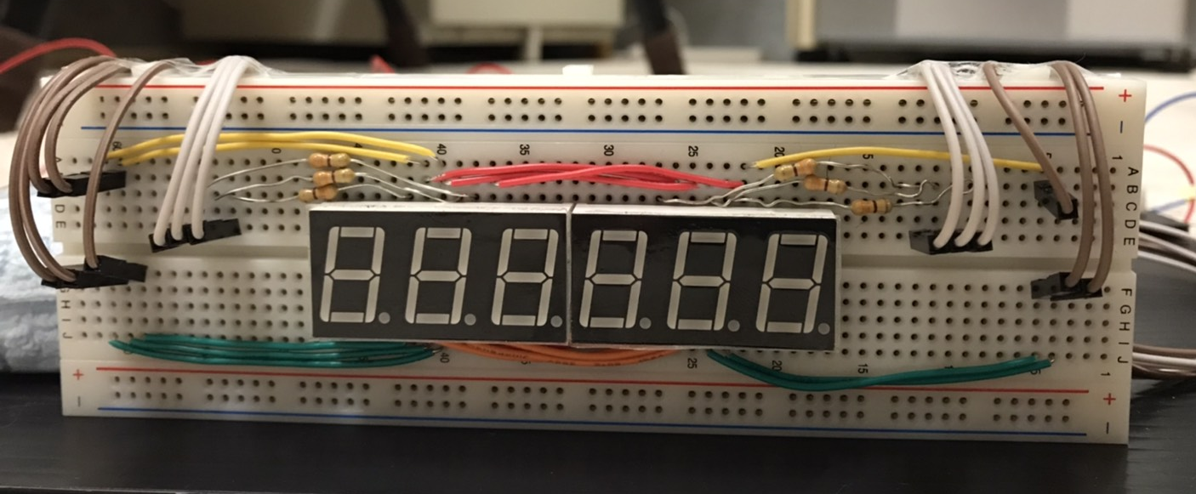
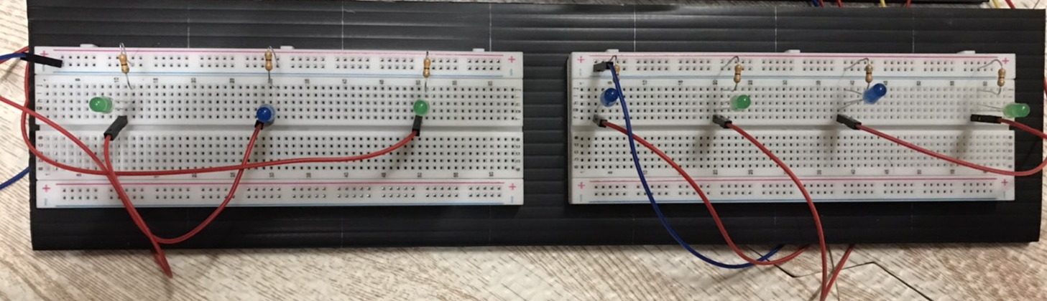
INTRODUCTION
Name: Day-Telling Digital Clock
Materials needed:
Electronics:
Breadboard (4)
7-segment display (6)
LED lights (7)
Buzzer
Resistors
Potentiometer
Battery
Copper wire
PMOD cables
Keyboard
Casing:
Plastic boards
Functions:
Show date, time and current day
Stopwatch (3 record slot, pause/play)
Timer (3 record slot, pause/play, reminder when timer reaches 00.00.00)
Alarm (10 slot, reminder when timer reaches 00.00.00)
Reset (Reset everything)
6 7-segment display circuit
Buzzer circuit with potentiometer
LED circuit

Slide 3
DESIGNING THE CIRCUIT (I) – LED CIRCUIT
The ground of the FPGA is connected to the negative port of the breadboard
Each LED is connected with a 330 ohm which will also be connected to the negative port of the breadboard
Each PMOD cable is connected from the PMOD port to the breadboard
The positive lead of the LED (the longer lead) will be placed in the same row as the PMOD cable and the negative lead of the LED (the shorter lead) will be place in the same row as the resistor

Slide 4
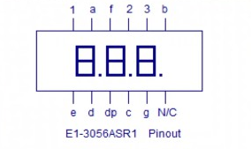
DESIGNING THE CIRCUIT (II) – SEVEN SEGMENT CIRCUIT
The copper wires here is used to make the circuit more organized and to connect the a, b, c, d, e, f, g, dp pins of both 12-pin 7-segment together so that it can be controlled by the same signal from the FPGA
12-pin 7-segment Datasheet
This is the same 330 ohm resistors which is used to connect the PMOD cable with the power pin of the 12-pin 7-segment

Slide 5
DESIGNING THE CIRCUIT (III) – BUZZER CIRCUIT
This is the buzzer, it is covered with a piece of cloth so that when it vibrates, it wont make any noise, because since that we are using an external power supply, the buzzer will continue to vibrates a little bit even if the FPGA is off, so to fix that problem we decided to cover the buzzer in a piece of cloth and if the signal given to it is 0, it will then play the buzzer sound.
The potentiometer here is used to adjust the resistance in the circuit so that it will increase the buzzers volume
Here we also use an external power supply (9V) so that the buzzer will have an increase in volume

Slide 6
FSM OF THE PRODUCT
1
CLOCK
2
SHOW_CLOCK
Explanations:
All digit shown in the 7-segment is 0
Done inputting time and date and press enter
Press ‘Esc’ key
‘ALARM0’ + Enter key
‘TIMER0’ + Enter key
‘STOPW0’ + Enter key
Press ‘Esc’ key or all 10 alarm slots are filled
Input desired time + Enter key
‘RESET0’ + Enter key
INITIAL
3
CHANGE_MODE
9
4
6
5
ALARM
TIMER
SHOW_STOPWATCH
7
8
SHOW_ALARM
SHOW_TIMER

